Slide 1

Leading the HD/Megapixel Resolution Revolution

Slide 2
Corporate Overview
Incorporated in 1998 – Privately Held
Headquartered in San Juan Capistrano, CA
  Engineering, Design, Test Labs, Product Testing, Quality Assurance, Operations
  Inside Sales, Tech Support, Customer Service, Marketing, HR, Shipping and Finance
EMEA Office in Amsterdam, The Netherlands
  Inside Sales, Tech Support, and Customer Service
Manufacturing in South East Asia

Slide 3
Quality Overview
IQinVision requires optimized temperatures for soldering profiles for PCBA’s (Printed Circuit Board Assembly) resulting in ideal solder joints and fewer latent soldering defects.
IQinVision requires mandatory baking of bare PCB’s (Printed Circuit Board) and IC’s (Integrated Circuit) prior to SMT (Surface Mount Technology) to remove moisture from boards. This results in improved solder joints and latent defects for IC’s.
IQinVision conducts 100% thermal testing during 12 hour ‘burn-in’ of all cameras at 50C. This results in accelerated infant mortality of soldering defects and component failures during the burn-in test rather than out in the field.
IQinVision performs Thermal Cycling of every shipment, -20C to +50C for 12 hours on an AQL sample basis.
IQinVision conducts 100% Eagle Eye testing of all lens types. All lenses are visually inspected for cosmetic issues and tested for optimal performance.

Slide 4
Quality Overview Continued…
IQinVision holds monthly RMA/Field Quality meetings to review all field quality and reliability issues. There is active participation from Operations, Engineering, Tech Support and Marketing. Meeting minutes are published and action items are assigned and tracked to closure.
Monthly MTBF data is calculated, reviewed, and analyzed for trends and continual improvement.
IQinVision cameras have extraordinary field reliability with over 250,000+ hours MTBF for most camera models. IQinVision’s passion is designing and producing high quality, reliable IP cameras. This is reflected in IQinVision’s rigorous design qualification and manufacturing processes which include HALT/HASS testing, 4 corner Temperature/Electrical Maximum Functionality testing, 12 hour production burn-in testing, and optimized soldering profiles and processes for the RoHS-designed, environmentally friendly technology used by IQinVision.

Slide 5
Benefits of Megapixel Resolution
Technology Overview
Larger field-of-view
Better Resolution
Greater digital zoom image detail
Fewer cameras needed – less installation and maintenance cost (TCO)
Replace mechanical PTZ – never miss a thing
Benefits of IQ Megapixel
Full Resolution Range: SD480p – 5.0 Megapixel
Complete line of enclosures (including Sentinel, IP66/NEMA 4/POE/ 6 watts total power)
14 years experience – Mature Sensor/Megapixel Technology
Built-in on camera tools - IQeye cameras as a ‘platform’
Strong Channel Strategy and Partnerships
Notes:
Now here are some of the key benefits of megapixel resolution which you will see explained further in the next few slides
Read through each one quickly
GO to next slide

Slide 6
Why IQinVision
Highest Quality and Lowest Failure Rates
    — Quality control at the factory and every camera is tested before customer shipment.
    — Low out-of-box failures
World Class Technical Support & Service
    — 14 hour a day support
    — 6 Languages Supported
Standard 5-Year and 3-Year Warranty’s and Advanced Replacement
    — Extended Warranty Available
    — RMA Process
Highly Profitable IP Solution
    — High Gross Profits
    — Limited Channel Strategy
Registration and Evaluation Programs
    — Provide the best pricing to the team that leads with IQinVision
    — Block competitors from getting special pricing

Slide 7

Resolutions Compared
IQeye 5.0 MP
2560 x 1920
IQeye 3.1 MP
2048 x 1536
IQeye 3.6 MP
2560 x 1440
IQeye 2.0 MP / HD1080p
1600 x 1200
IQeye 2.0 MP / HD1080p
1920 x 1080
IQeye 1.3 MP
1280 x 1024
IQeye 1.0 MP / HD720p
1280 x 720
PAL 720 x 576
VGA
640 x 480
IQeye 0.3 MP / SD480p
720 x 480
SIF
352 x 240

Slide 8
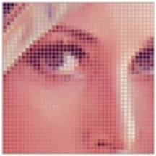

What is Resolution?
It’s all about the pixels…
Pixel: is short for a 'picture element', and describes
a point on a display screen…
Resolution: The total number of pixels in an image… also described by pixels per length, such as pixels per inch.
1x1
2x2
5x5
10x10
20x20
50x50
100x100
Illustration of the letter R at varying pixels /inch (cm)

Slide 9
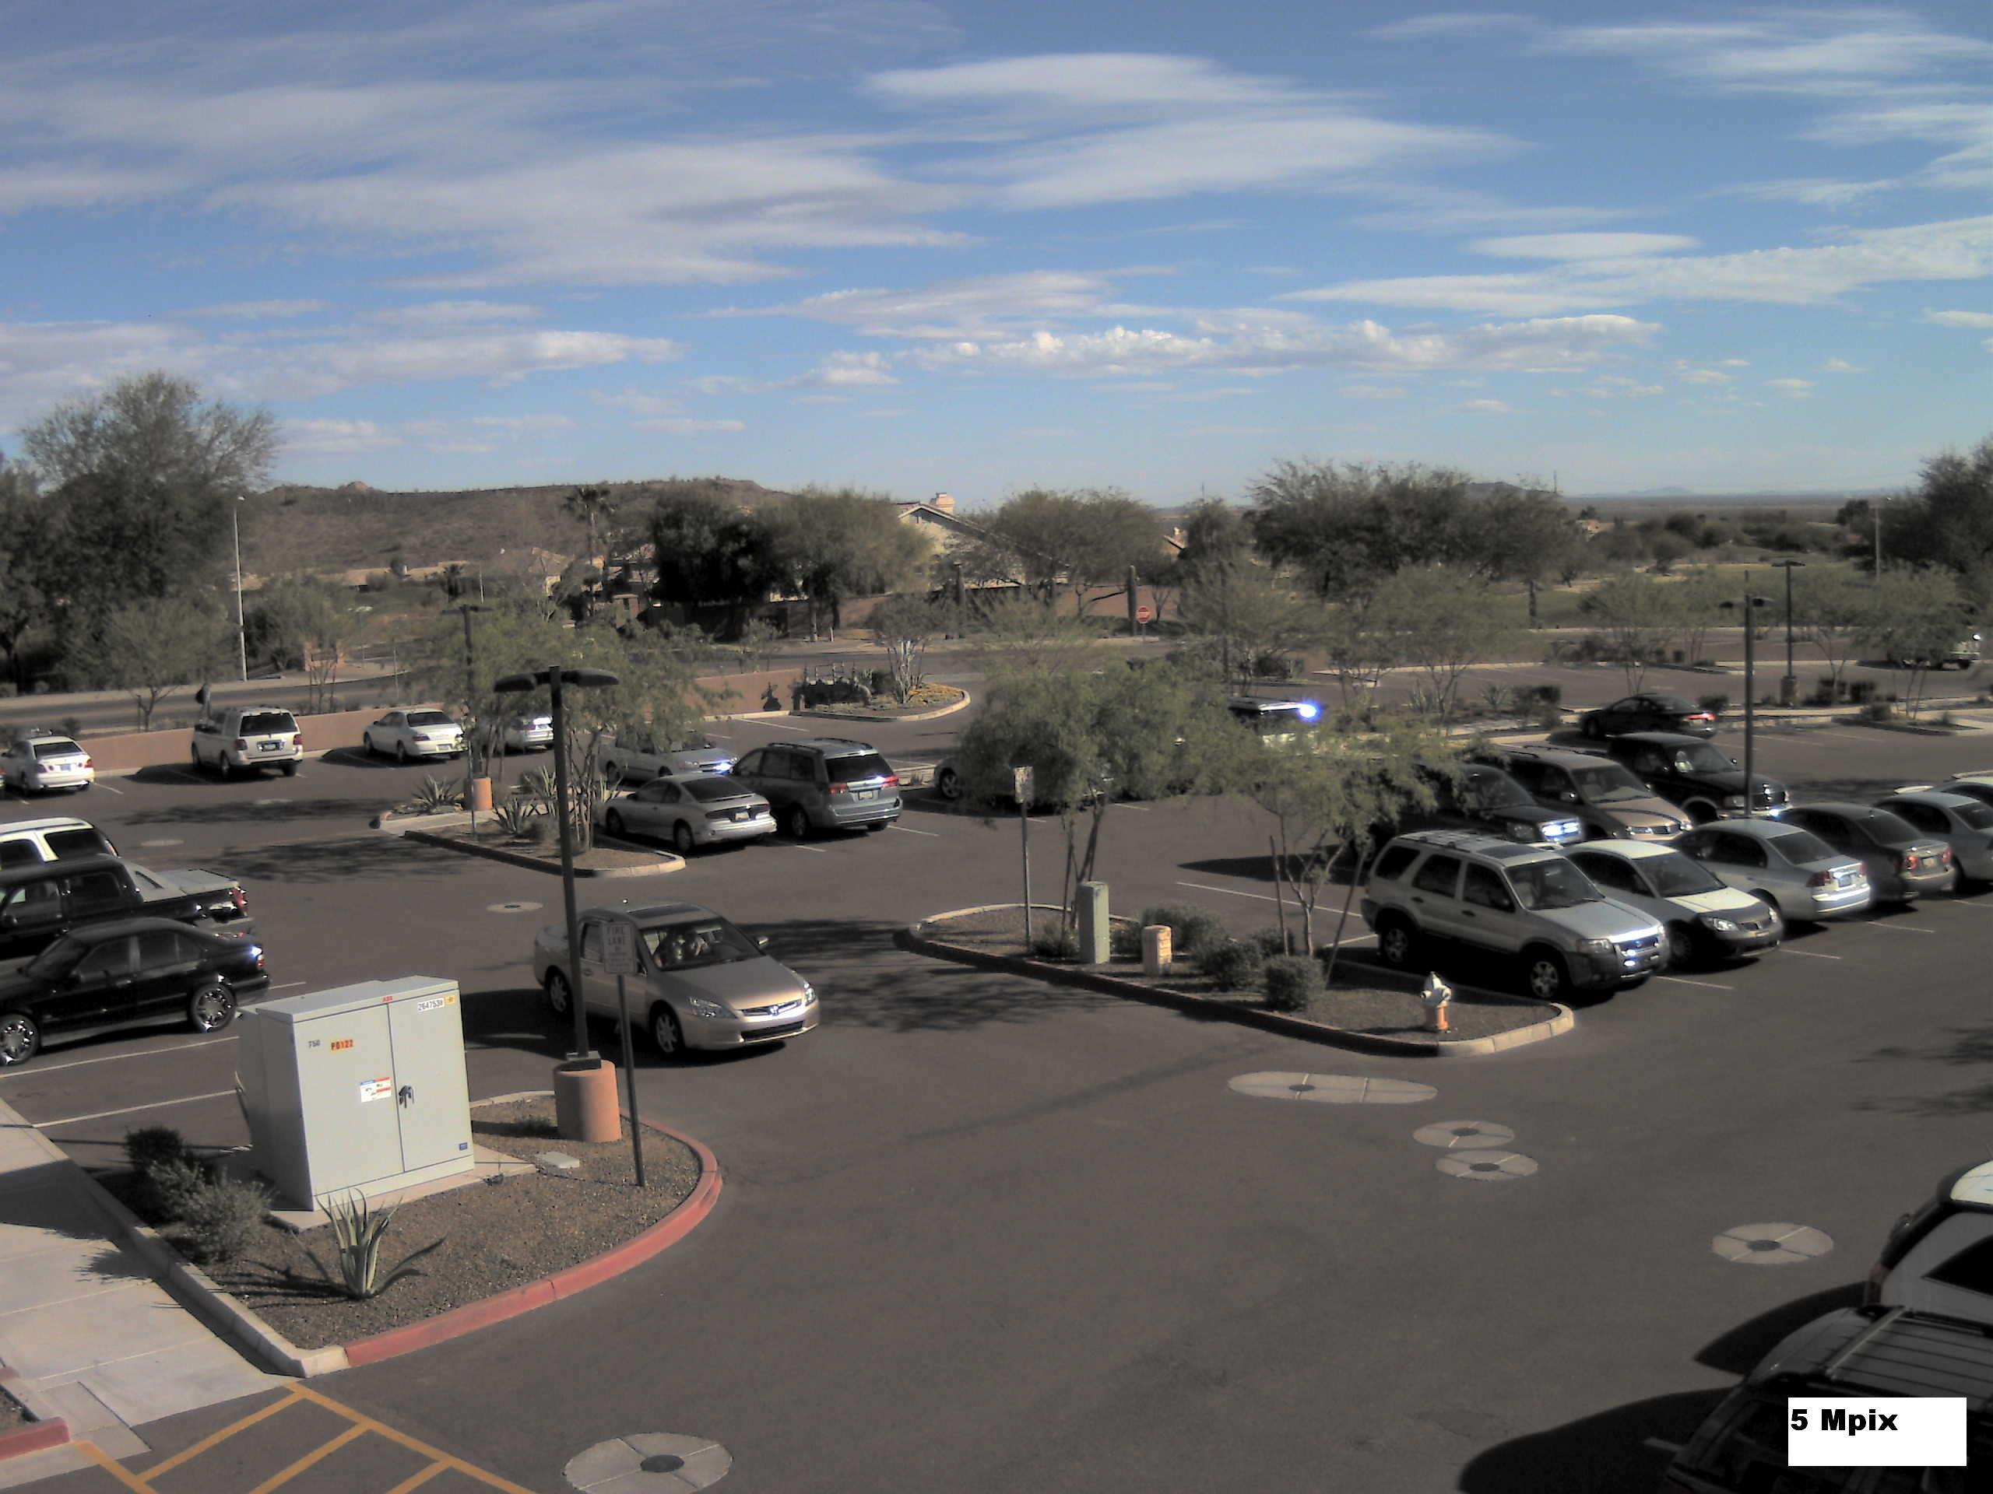
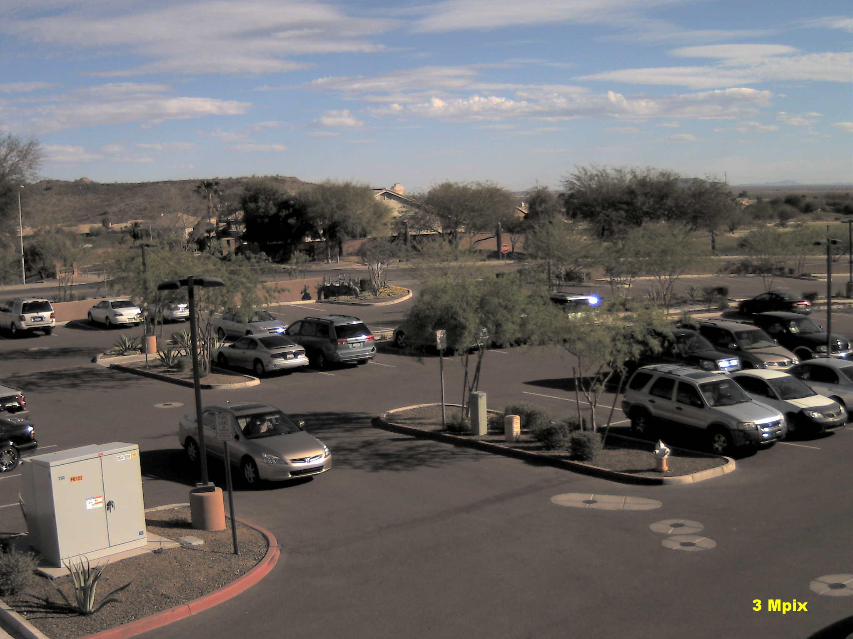
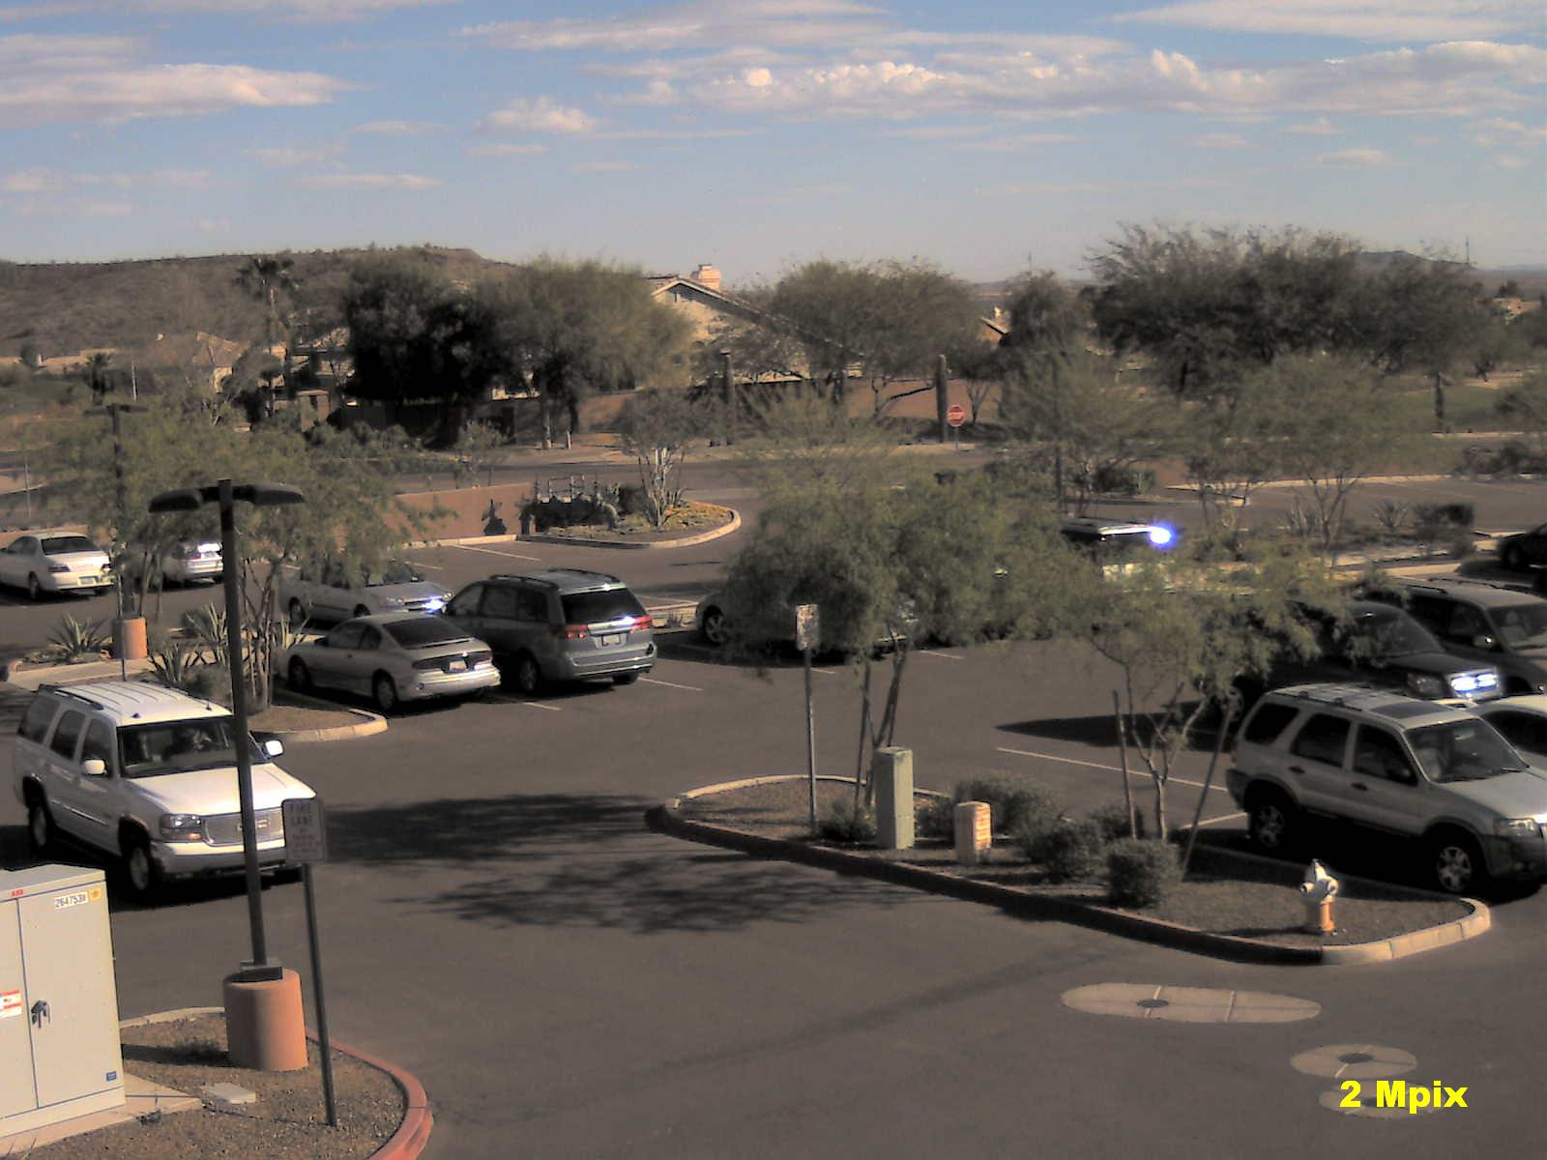
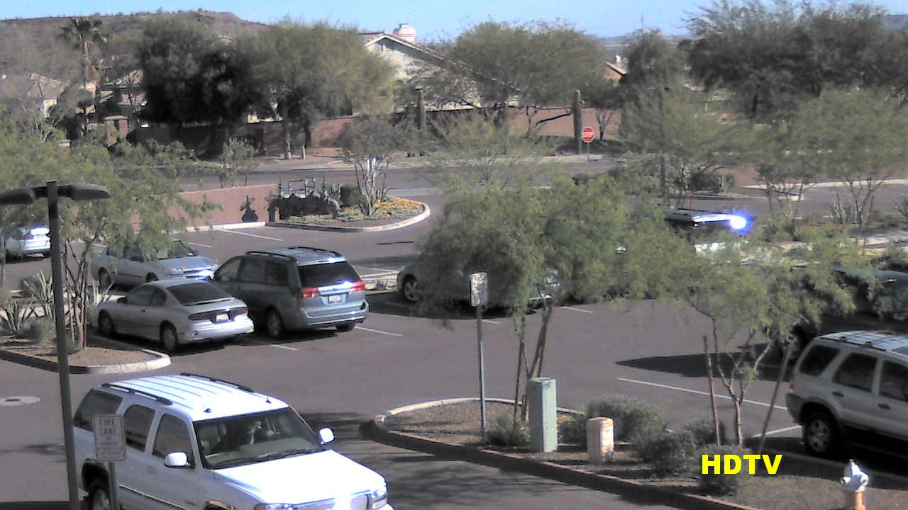
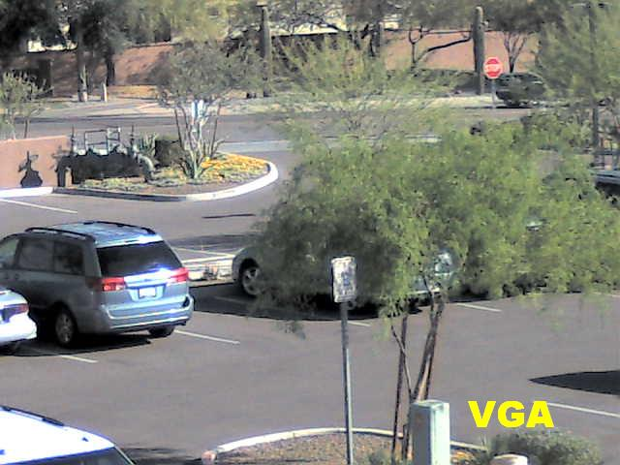
5 megapixel

Slide 10
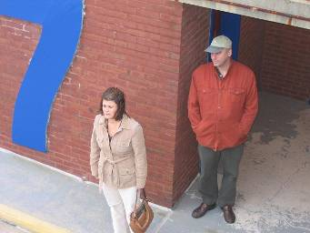

Megapixel Resolution = Greater Digital
Zoom Image Detail
What they have
What they want

Slide 11
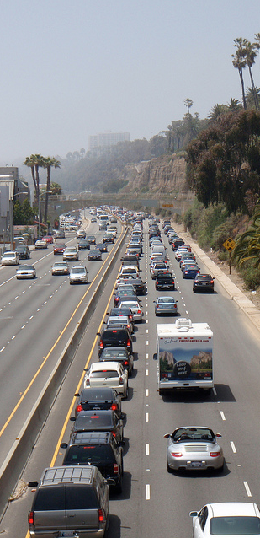
General Surveillance
See general activity, no need to
recognize specifics
Typical Applications
Traffic
Stadiums
Shopping malls
Parking Lots
Military
20
Pixels Per Foot on Target

Slide 12
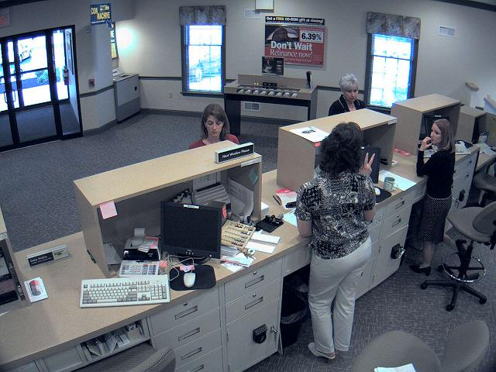
Forensic Detail
Capture maximum amount of detail
Typical Applications
Retail
Banks
Schools
Casino Floors
Parking Lot Exits
Airports
40
Pixels Per Foot on Target

Slide 13
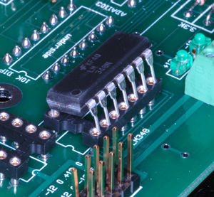
High Detail
Get maximum coverage area with enough detail
to recognize faces, read number plates etc…
Typical Applications
Cash Counting rooms
Pharmaceutical
Retail (Registers)
Casino/Gaming Tables
Process Automation
80
Pixels Per Foot on Target

Slide 14
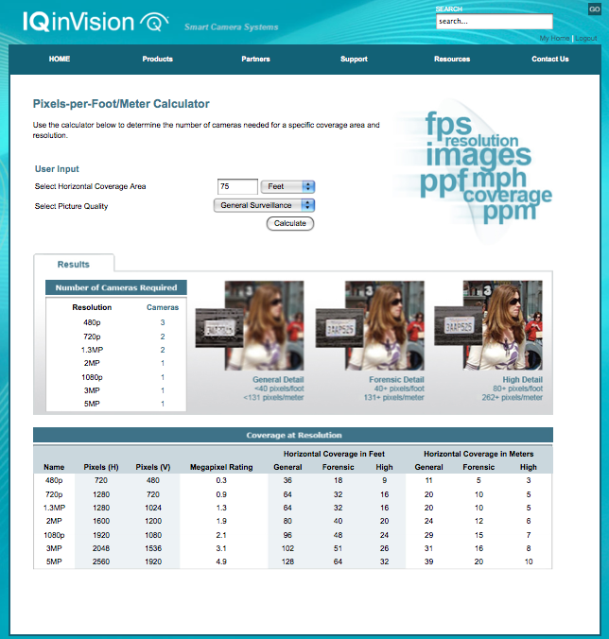
Pixels-per-Foot/Meter Calculator

Slide 15


What they have
What they want

Slide 16
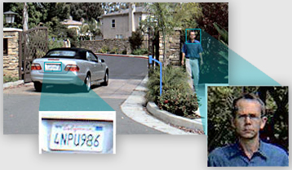
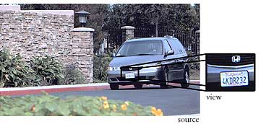
Digital Pan/Tilt/Zoom
Allows you to virtually move around a large image using a smaller viewing window.
No moving parts
Capture everything, all the time
Multiple simultaneous control

Slide 17
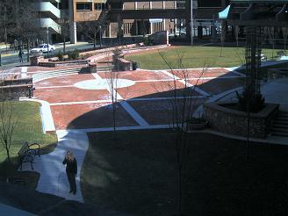




IQeye Digital PTZ
How much zoom do you need?
Digital zoom @ d1
Digital zoom @ cif
IQeye Zoom @ 2 Megapixel
IQeye DPTZ 3.1 Megapixel
IQeye Zoom @ hdtv

Slide 18
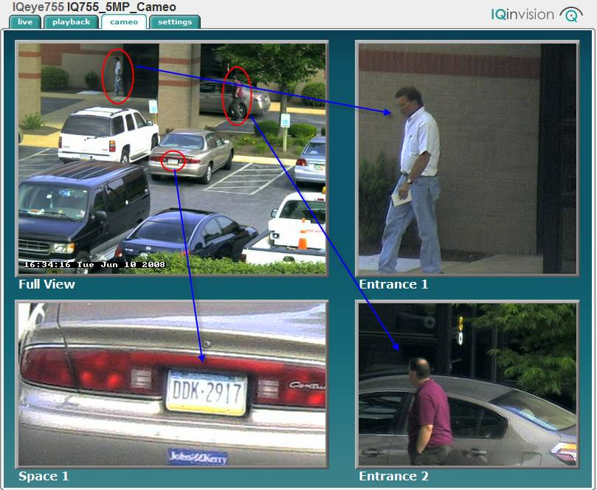
CAMEO

Slide 19
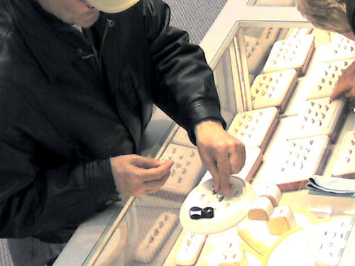
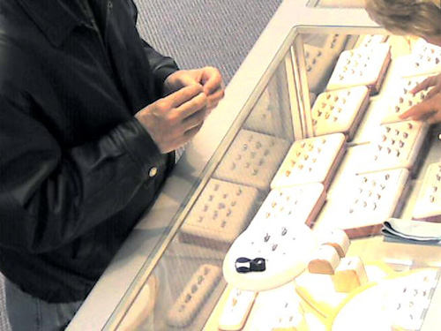
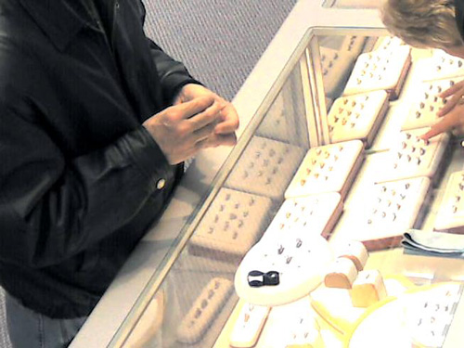
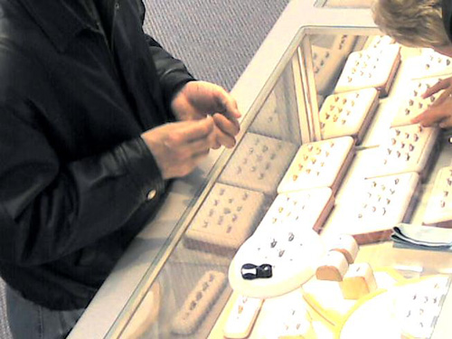
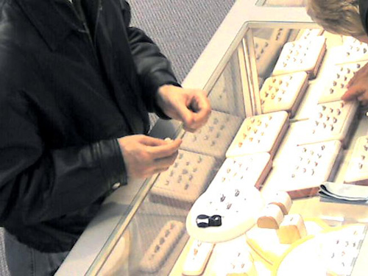
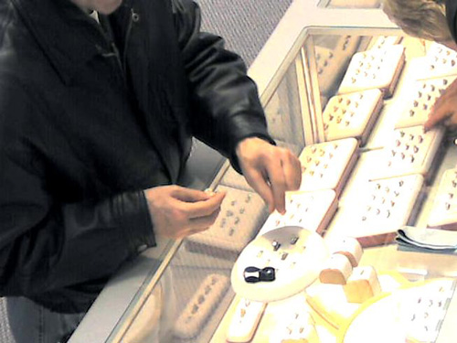
Zoom in with IQ Video Quality

Slide 20
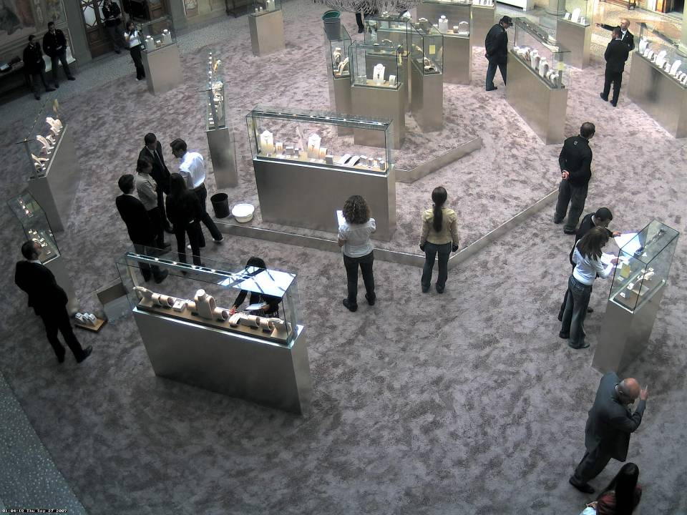
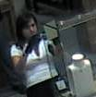


Megapixel Resolution = Replace Mechanical PTZ
Notes:
And speaking of “Never missing a thing” here’s an image from a high-end International jewelry store called Bulgari.
Click Animation to zoom windows - Using a 5 megapixel camera, they were able to cover most of their show floor without the risk of missing anything. When you consider there’s over $250 million dollars worth of product on display, that’s pretty important!
GO to next slide

Slide 21
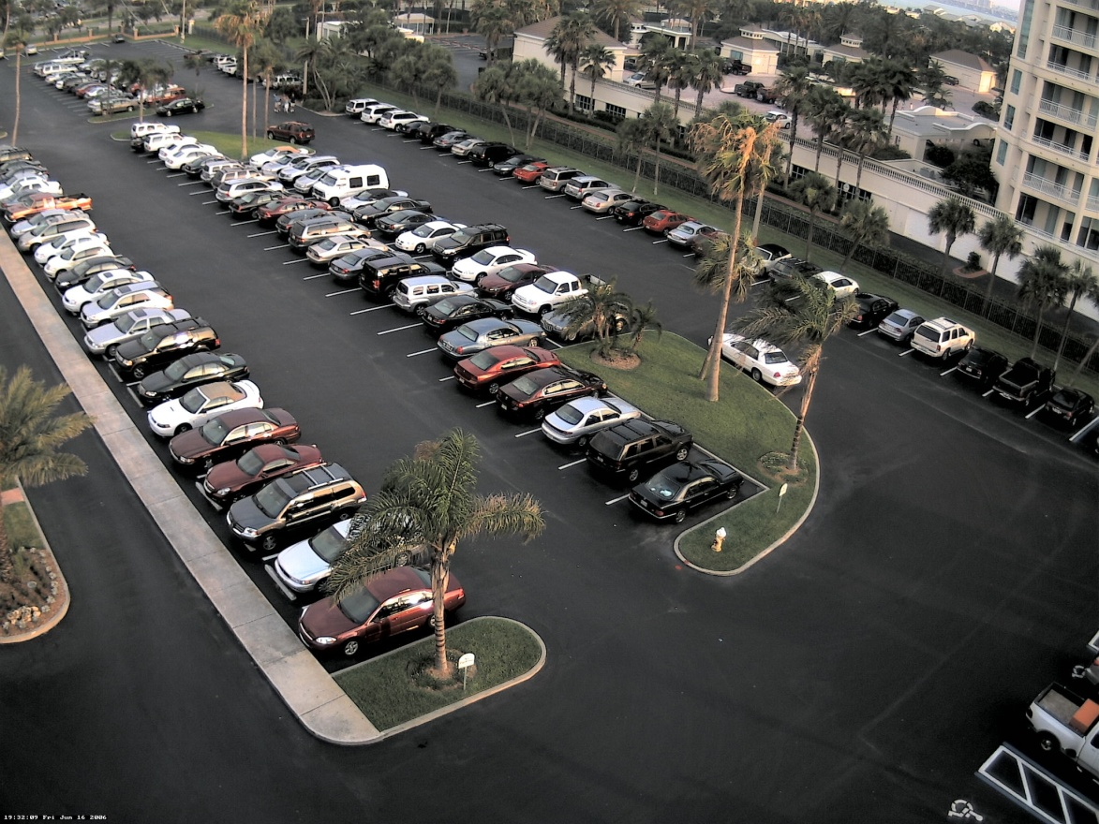
The Megapixel Myths... too much storage
45KB
40KB
57KB
36KB
Total 178KB with 4 Cameras

Slide 22
The Megapixel Myths......
140KB
One IQ702 - 2.0 Megapixel IP Camera

Slide 23
H.264 Considerations
Select H.264 when your requirements dictate that saving bandwidth is more important than consistent image quality or predictability in bandwidth or storage needs.
Select H.264 when your requirements are to:
— Record at 15 fps or higher
— Good lighting conditions
— Minimal motion
Select MJPEG when you need very high quality with consistent and predictable bandwidth and storage.

Slide 24
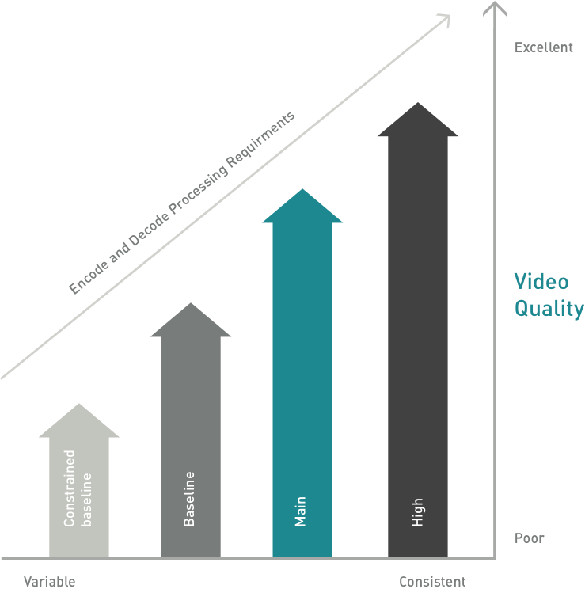
IQinVision Supports H.264 “MAIN” Profile
Predictability vs Markting Hype
Cost of Implementation vs Cost of Storage
Enterprise Class vs Consumer Grade (Mobile)
Quality of Video vs Ease of Implementation
http://www.adobe.com/devnet/flashmediaserver/articles/h264_encoding_03.html

Slide 25
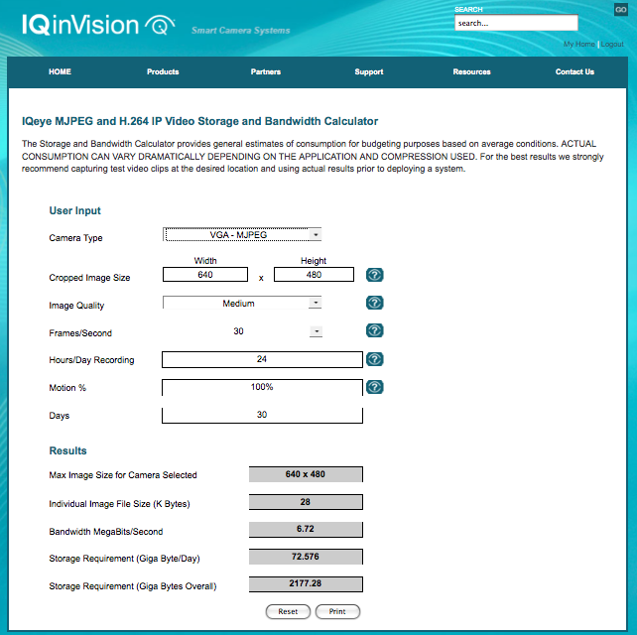
Storage Calculator on Web

Slide 26
Fewer cameras needed = lower TCO
Facial and License Plate Recognition = 40 pixels per ‘ft
(total number of horizontal pixels /40 = coverage area)
VGA = 16’
640/40
HDTV = 32’
1280/40
2 MP = 40’
1600/40
3 MP = 51’
2048/40
5 MP = 64’
2560/40
To cover a 65’ area you need
(4) VGA cameras or
(1) 5 Megapixel camera
Notes:
Megapixel = fewer cameras.
For high quality video surveillance, it’s all about Pixels-per-foot
Using 40 pixels/foot as our baseline and dividing that into the following resolutions, we can determine the horizontal field-of-view coverage.
CLICK to animations for each res.
As you can see, the higher the resolution the greater area we can cover with useable video.
CLICK last animation – for example, to cover a 65’ are you would need 4 VGA or a single IQ705 5 megapixel camera
That means with megapixel resolution, you can use fewer cameras and reduce total cost ownership

Slide 27
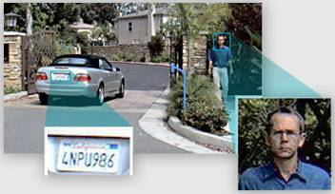
Megapixel Resolution = Replace Mechanical PTZ
Alternative to unmonitored mechanical PTZ
No moving parts to wear out
No Blind Spots - capture everything, all the time
Multiple users with simultaneous control
Pan around the scene without moving the camera
Clear digital zoom on recorded images
Never miss a thing

Slide 28
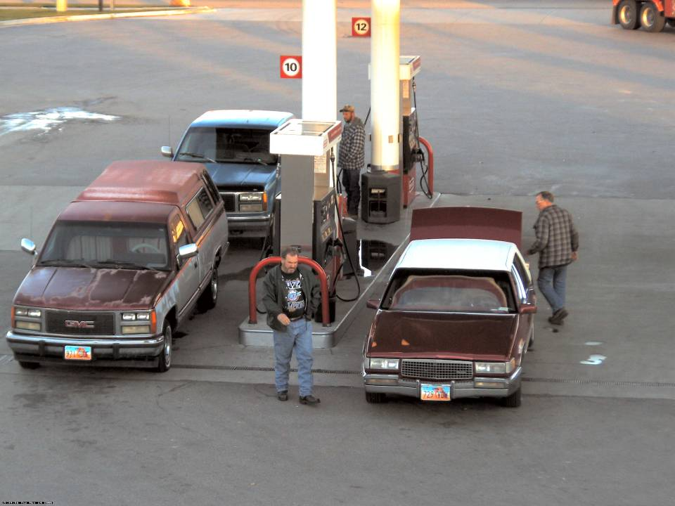
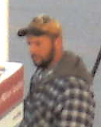
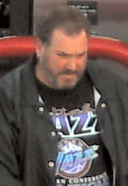
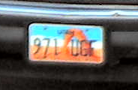

Notes:
This truckstop/travel plaza customer is using 5 mpix cameras to capture drive offs which is much more frequent these days due to higher fuel costs. The requirement was to capture faces and license plate on both sides of the fuel island. With cameras station from 70 to 100 feet away, this was an application only megapixel could support.

Slide 29
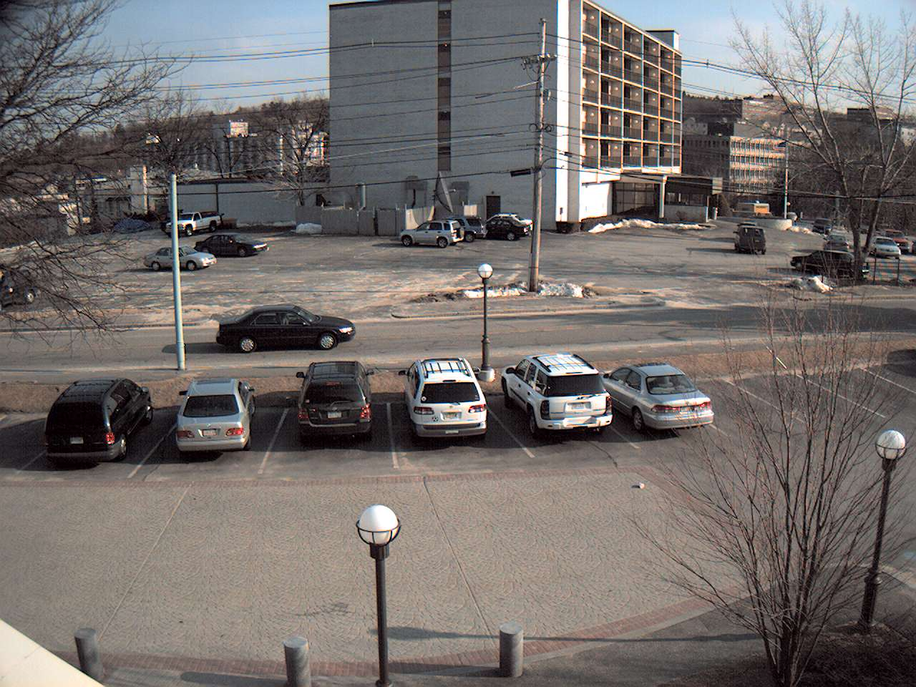
Image Cropping
CCTV
Wasted
Video
Megapixel quality video
smaller file size
Save on Bandwidth and Storage
Notes:
Traditional CCTV cameras and IP cameras confine users to a 4:3 aspect ratio as you see in this image – CLICK for animation
Now, let’s suppose the region of interest are the cars in the parking lot. - CLICK for animation to show wasted video
With IQeye’s cropping feature we can select only the portion of the scene we care about thus eliminating the useless video and reducing the file size and therefore BW and storage – CLICK to animation of cropped image

Slide 30
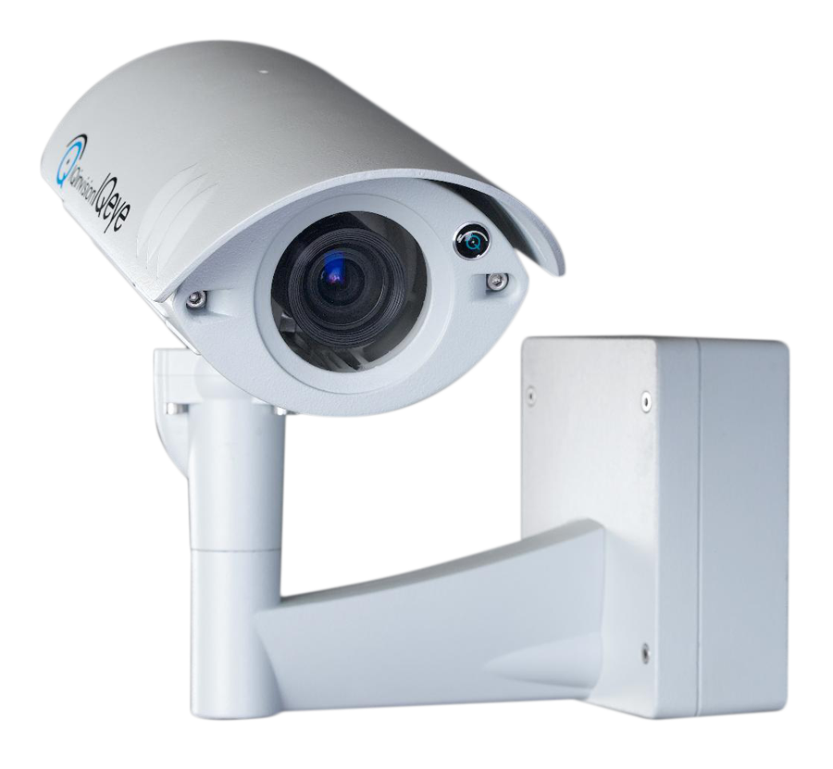
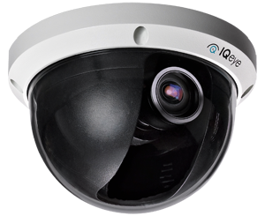
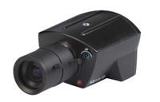
IQeye Camera Line -- Key Selling Points & Features
Pure IP Solution
    — SD480p, HD720p, HD1080p, 3.1MP, 3.6MP & 5MP
    — H.264 & MJPEG Compression
    — Low-power Consumption
    — Power-over-Ethernet
Lower Total Cost of Ownership
    — Utilizing IP Infrastructure
    — Higher Resolution
    — Larger Field of View
Industrial Design, Interchangeable Lens
Integrated Solution for Ease of Installation
and Maintenance

Slide 31
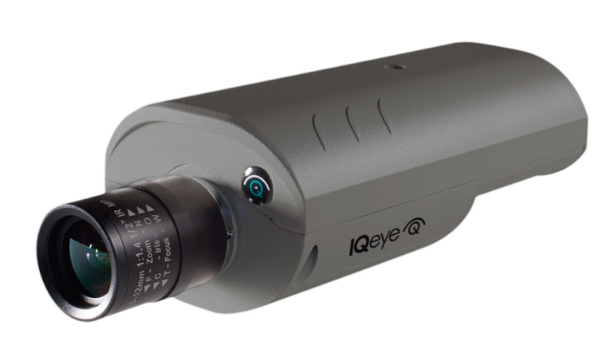
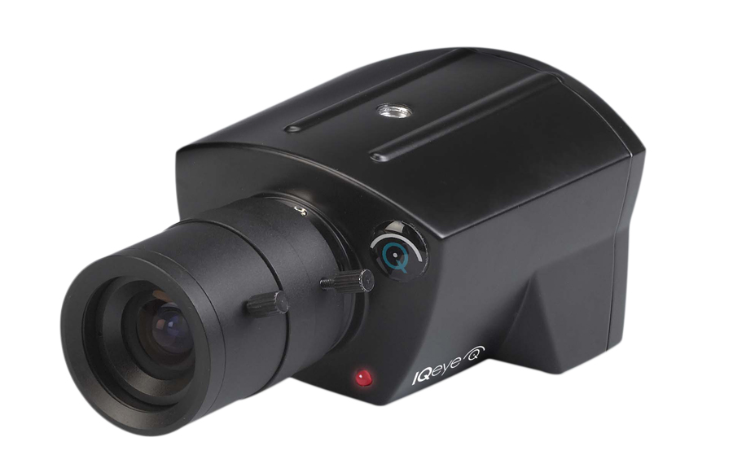
Key Selling Points and Features
High-Quality Images with Digital Pan/Tilt/Zoom (PTZ)-
    — No Moving Parts - Never Miss a Thing
Excellent Low-Light Performance and Day/Night Capabilities
Digital exposure windows
Analog Output – Dual Stream or Focusing Tool
Multi-zone Motion Detection and Privacy Masking
Digital exposure windows
On-camera storage: Compact Flash and SD
Applications: Cameo, IQaccess, IQmanager, IQsentry, DTS
Analytics ready
Stable and Proven Across Market Segments

Slide 32
Product Overview
Sentinel, IQ76x, and Alliance-pro Series Features
SD480p, HD720p, HD1080p, 3.1MP, 3.6MP & 5MP
H.264 & MJPEG Compression
12-24VDC or 24VAC aux input
Single lens Day/Night
Multi-zone motion detection and privacy masks
Digital exposure windows
On-camera applications
    — IQcameo, IQaccess, IQrecorder, Direct-to-Storage (DTS)
Digital I/Os
Analytics ready
IQfocus & analog output
On-camera storage: Compact Flash and SDHC
3 year warranty (5-year Warranty on Alliance-pro)

Slide 33
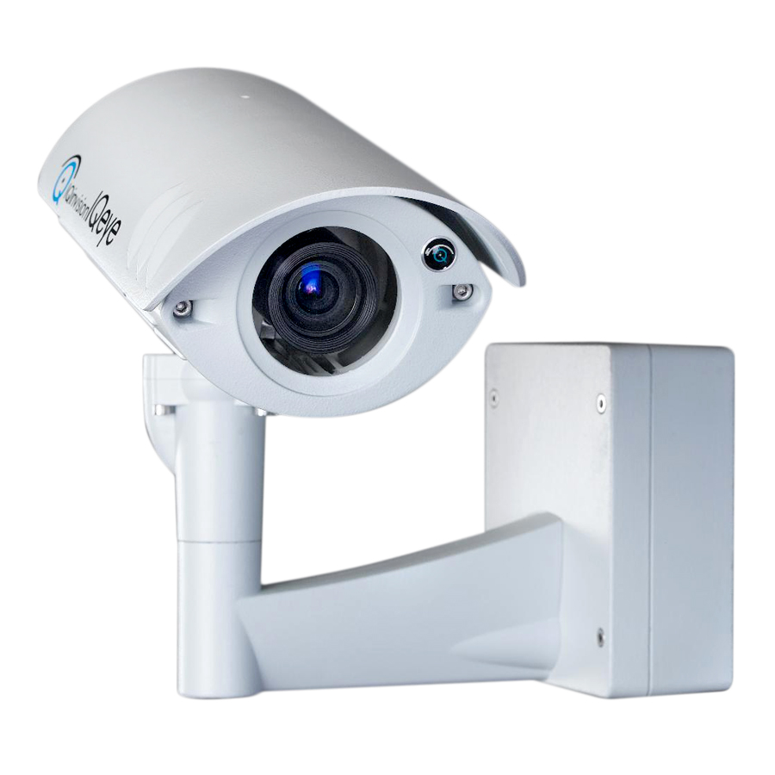

IQ Sentinel Series
  H.264 and MJPEG compression
  Full HD1080p (1920 x 1080) @ 30 fps (H.264)
  HD720p, HD1080p, 3.1MP, 3.6MP, 5MP
  Remote Back Focus
  ONVIF and PSIA compliant
  Standard & Day/Night models
  Megapixel varifocal lens
  -22F (-30C) to 122F (50C)
  IP66 / NEMA 4 enclosure
  <7 watts power consumption (including heater)
  Pivoting mounting arm
  Digital Pan/Tilt/Zoom
  Alarm I/Os
  Video Port for focusing
  Multi Zone Motion Detection
  3 Year Warranty

Slide 34
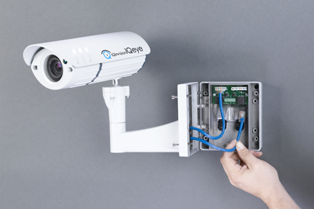
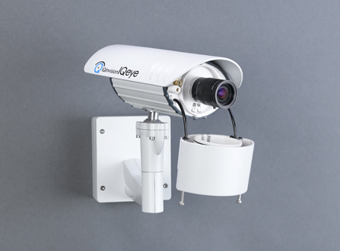
Sentinel Series ease-of-installation
Separate “back box”
(with installation hangers)
Cable attached lens snouts
360°Pan, 180° Tilt
Single tool for all access points

Slide 35
Sentinel Series ease-of-installation
Installation Hangers on both sides
Everything is clearly
labeled. Lots of room in
J-box to tuck cables
Ethernet via RJ-45
or punch down
Twin Heyco sealed connectors
Notes:
Note that the junction box is so well sealed that merely seating the cover on the box seals it. No torquing of the screws is needed. It just works.

Slide 36
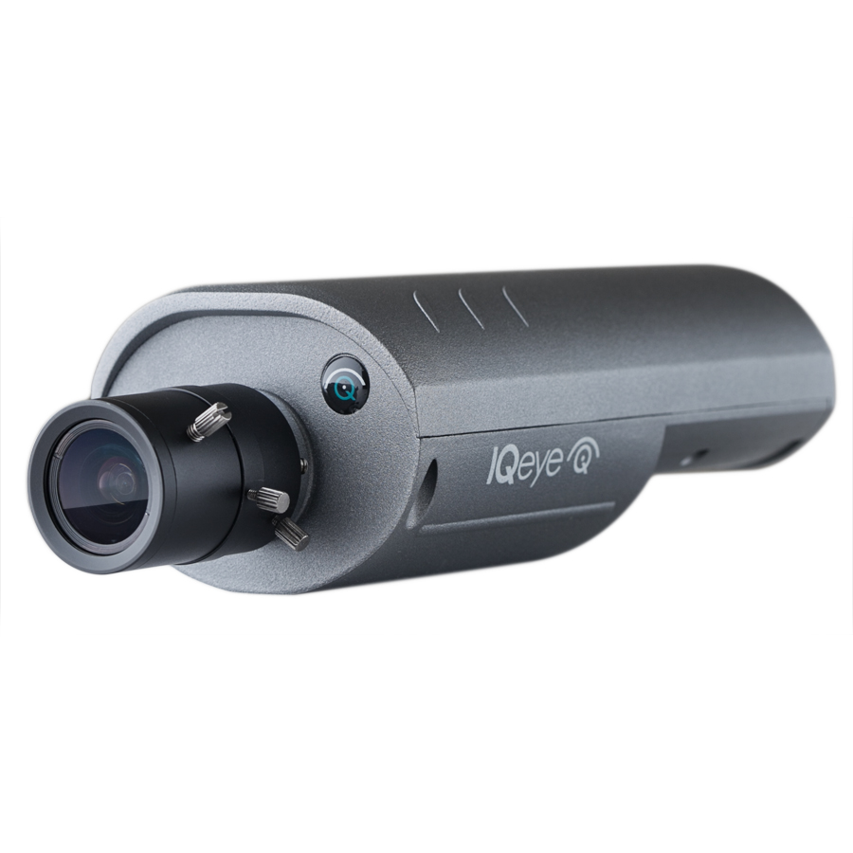
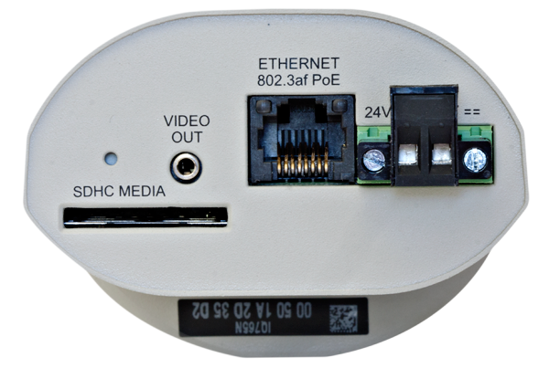
IQeye 7 Series
HD720p, HD1080p, 3.6 MP, 3.1 MP, and 5 MP Resolutions
Remote Back Focus
H.264 main profile + MJPEG Compression
Two-way audio
60 fps @ HD720p, 30 fps @ 1080p, 10 fps @ 5 MP
Day/Night movable IR filter
LightgrabberTM II low-light feature
On-camera storage
Direct-to-Storage (DTS)
Analog video out
3-Year Warranty
24VAC, 12-24VDC
PoE Ethernet 802.3af Class 3
Trigger In/Out
Factory reset button
Standard 1/4-20 camera mount

Slide 37
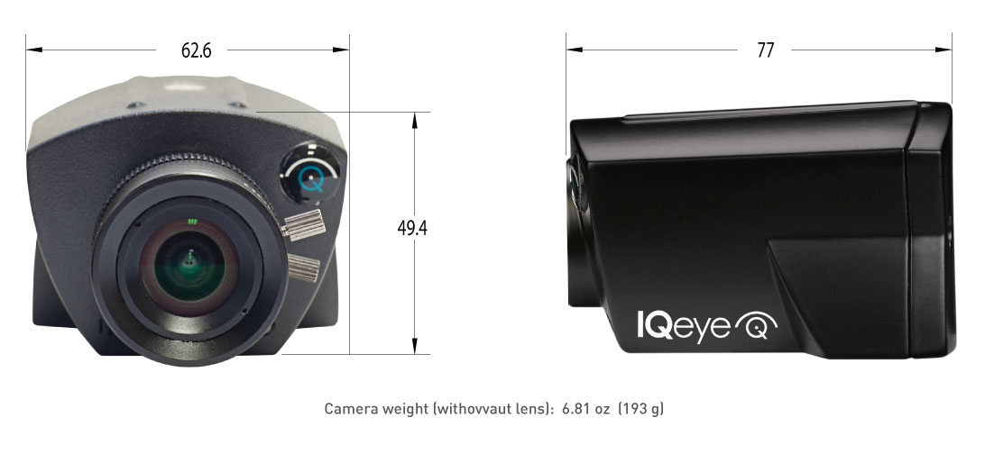
3 Series Camera
  Resolutions up to HD1080p
  H.264 Main Profile + MJPEG Compression
  60 fps @ SD480p, 30 fps @ HD720p and HD1080p
  One-Way Audio w/ Built-in Microphone
  Lightgrabber™ II Low-Light Feature
  Power-over-Ethernet
  Cast-Aluminum
  Direct-to-Storage (DTS)
  ONVIF and PSIA Compliant
  5-Year Warranty

Slide 38
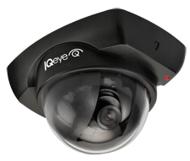
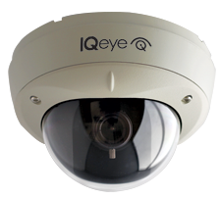
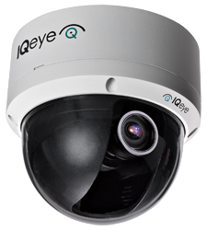
Alliance Series

Slide 39
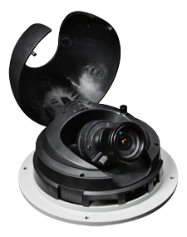

Alliance-pro
  SD480p, HD720p, HD1080p, 3.1MP, & 5MP
  H.264 Main Profile + MJPEG Compression
  Vandal-resistant GE Lexan bubble
  Audio input
  Interior or exterior w/ heater/blower
  Extreme temperature ranges (-22 F to 122 F)
  <7 Watts Power for IP66/NEMA 4 Enclosure
  True day/night with auto IR cut filter
  Low-profile, surface mount
  True 3-axis gimbal
  Pivoting shroud & back plate
  SD/SDHC card slot
  Varifocal Lens
  IQfocus and full time analog outputs
  5-Year warranty
  Direct-to-Storage (DTS)
Notes:
You may wonder why we waited so long to come out with a minidome…it wasn’t for a lack of Asian manufacturers wanting to build one for us. It’s because, like everything else at IQinvision, we wanted to get it right.
When we were designing the Alliance dome we looked at a lot of domes and it seemed most were designed for the consumer market. They were plastic, some had thin bubbles and were cumbersome to install.
It was apparent that other vendors were more concerned with cutting out manufacturing costs than designing a truly solid, professional-grade product.
So what differentiates the IQeye Alliance? First, lets take a look at the hardware…
The IQeye Alliance is aluminum with an impact resistant GE Lexan bubble that can withstand a ton of pressure.
It’s low profile design makes it inconspicuous but not covert.
The entire camera was designed to be surface mounted with a “flush mounted look” without having to cut into the ceiling. Also, it is designed with a true 3-axis gimbal that allows you to position it in a wide variety of mounting applications very easily.
With regard to innovations… With a lot of the domes we looked at, you had to adjust to the camera then align the shroud, if they weren’t optimized you had to start again which was frustrating. The Alliance’s pivoting shroud solves that problem, just optimize the field of view and focus the picture and the shroud will snap perfectly in place, we’ll demonstrate this in a minute.
We also knew that sometimes light could reflect off the electronics so we installed a black plastic cover over the electronics to eliminate reflection making it difficult to see which way the camera is pointing even though it is a clear bubble.
The clear bubble also means better low-light performance.
We designed a custom megapixel board mount lens for the Alliance. We have seen other companies put really cheap lenses on a megapixel camera and let me tell you, you can really make a megapixel image look bad with a lens that is not rated for the camera. It is like putting bike tires on a Ferrari.
One vendor (begins with A and ends with an S) uses the same non-megapixel lens for their VGA & megapixel minidome…

Slide 40
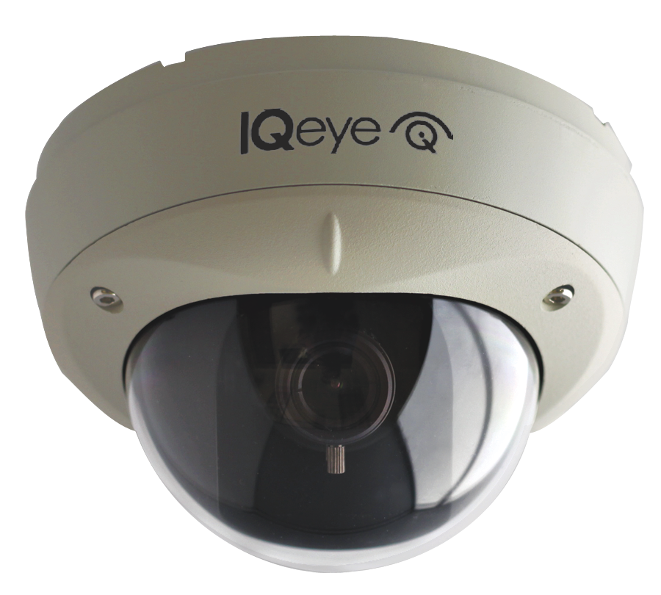
Alliance-mx
  SD480p, HD720p, HD1080p
  H.264 SD480p (720 x 480) @ 60fps
  H.264 HD720p (1280 x 720) @ 30fps
  H.264 HD1080p (1920 x 1080) @ 30fps
  Simultaneous H.264 & MJPEG Streams
  Indoor/Outdoor Surface Mount Dome (IP66 / NEMA 4)
  Day/Night (<0.05 lux)
  Vandal / Tamper Resistant
  Wide Range Varifocal Lens (3-13mm)
  PSIA & ONVIF Compliant
  On-Camera Multi Motion Detection Windows
  Low Power <3.8 Watts Power-over-Ethernet
  Two-Way Audio
  Bubble Size 3.8” / 98mm
  -20˚ to +50˚ C
  Lightgrabber II™ Low Light Feature
  5-Year warranty

Slide 41
Alliance-mini Features
  SD480p, HS720p, HD1080p
  H.264 Main Profile + MJPEG Compression
  60 fps @ SD480p, 30 fps @ HD720p and HD1080p
  Two-Way Audio with Built-in Microphone
  3-Axis Gimbal
  LightgrabberTM II Low-Light feature
  Power-over-Ethernet
  Cast-Aluminum
  Black and Beige Trim Rings Included
  Ceiling, wall and pendant mount options
  Direct-to-Storage (DTS)
  ONVIF and PSIA Compliant
  5-Year Warranty

Slide 42
Camera Overview
 | Sentinel | 7 Series | 3 Series | Alliance-pro | Alliance-mx | Alliance-mini
5 Megapixel | IQ865NE | IQ765NI | - | IQA35N | - | -
3 Megapixel | IQ863NE | IQ763NI | - | IQA33N | - | -
1080p / 2 Megapixel | IQ862NE | IQ762NI | IQ032SI | IQA32N | IQM32NE | IQD32SV
720p / 1.3 Megapixel | IQ861NE | IQ761NI | IQ031SI | IQA31N | IQM31NE | IQD31SV
480p / D1 | - | - | IQ030SI | IQA30N | IQM30NE | IQD30SV

Slide 43
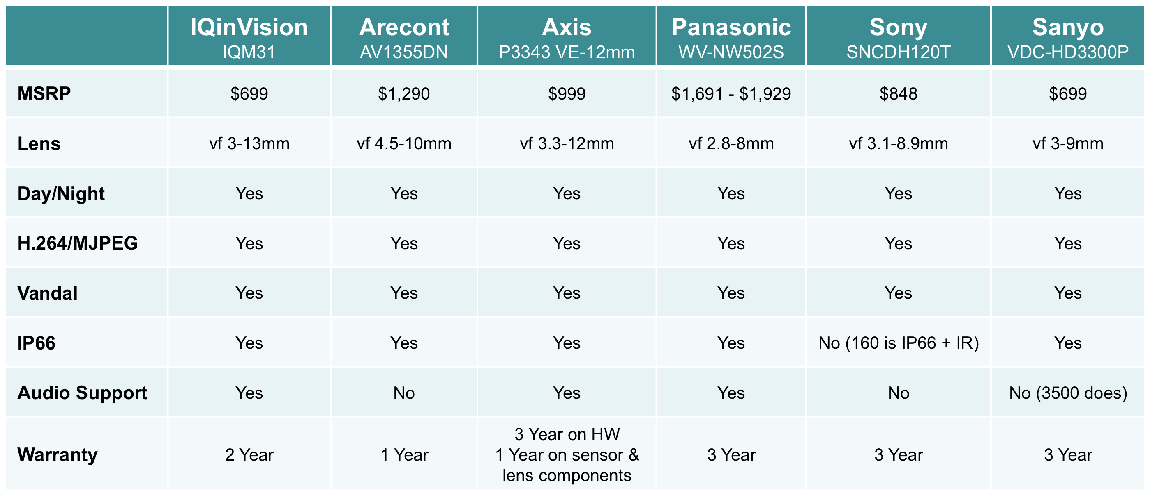
IQM31 Product Comparison
5 Year

Slide 44
IQM32 Product Comparison
 | IQinVision | Arecont | Axis | Panasonic | Sony | Sanyo
 | IQM32 | AV2155 | P3346-VE | WV-NW502S | SNCDH220T | VDC-HD3500P
MSRP | $799 | $1,490 | $1,399(Indoor) $1,499(Outdoor) | $1,691 | $1,098 | $899
Lens | vf 3-13mm | AVxx55: 4.5-10mm AVxx55-16: 8-16mm | vf 3 - 9 mm | vf 2.8-8mm | vf 3.1 - 8.9 mm | vf 3-9mm
Day /Night | Yes | Yes | Yes | Yes | Yes | Yes
Indoor/Outdoor | Yes | Yes | Yes | Yes | Indoor | Yes
H.264/MJPEG | Yes | Yes | Yes | Yes | Yes | Yes
Vandal | Yes | Yes | Yes | Yes | Yes | Yes
IP66 | Yes | Yes | Yes | Yes | No | Yes
Audio Support | Yes | No | Yes | Yes | No | Yes
Warranty | 5 Year | 1 Year | 3 Year | 3 year | 3 Year | 4 Year

Slide 45
IQA32 Product Comparison
 | IQinVision | Arecont | Axis | Panasonic | Sony
 | IQA32NI-B5 | AV2155DN | P3346-V |  | SNC-DH220T
MSRP | $999 | $1,490 | $1,399 | N/A | $1,098
Lens | 3-13 mm | 4.5-10mm | 3-9 mm | N/A | 3.1 - 8.9 mm
Day /Night | Yes | Yes | Yes | N/A | Yes
H.264/MJPEG | Yes | Yes | Yes | N/A | Yes
Vandal | Yes | Yes | Yes | N/A | Yes
IP66 | Yes | Yes | Yes | N/A | Yes
Audio Support | Yes | No | Yes | N/A | No
Warranty | 5 Year | 1 Year w/ Terms | 3 Years w/ Terms | N/A | 3 Year (1 Yr PTZ)

Slide 46
IQA32 Product Comparison
 | IQinVision | Arecont | Axis | Panasonic | Sony
 | IQA32NE-B5 |  | P3346-VE | WV-NW502s | SNC-DH260
MSRP | $1,049 | N/A | $1,499 | $1,691 | $1,398
Lens | 3-13 mm | N/A | 3-9 mm | 2.8 - 10mm | 3.1 - 8.9mm
Day /Night | Yes | N/A | Yes | Yes | Yes
H.264/MJPEG | Yes | N/A | Yes | Yes | Yes
Vandal | Yes | N/A | Yes | Yes | Yes
IP66 | Yes | N/A | Yes | Yes | Yes
Audio Support | Yes | N/A | Yes | Yes | No
Warranty | 5 Year | N/A | 3 Years w/ Terms | 1 – 3 Years | 3 Year (1 Yr PTZ)

Slide 47
IQA32 Product Comparison
 | IQinVision | Arecont | Axis | Panasonic | Sony
 | IQA32NX-B5 | AV2155DN-1HK
MSRP | $1,149 | $1,550 | N/A | N/A | N/A
Lens | 3-13 mm | 4.5-10mm | N/A | N/A | N/A
Day /Night | Yes | Yes | N/A | N/A | N/A
H.264/MJPEG | Yes | Yes | N/A | N/A | N/A
Vandal | Yes | Yes | N/A | N/A | N/A
IP66 | Yes | Yes | N/A | N/A | N/A
Audio Support | Yes | No | N/A | N/A | N/A
Warranty | 5 Year | 1 Year w/ Terms | N/A | N/A | N/A

Slide 48
IQtools
The right camera to meet customer needs.
  How do I capture license plates?
  How much storage do I need?
  How many frames per second is enough?
  What lens should I use?
  Go Green!
IQtools and Resources Online
> Bandwidth and Storage Calculator
> Pixels per Foot Calculator
> Frames per Second Calculator
> Lens Specifications
> Datasheets
LINK►

Slide 49
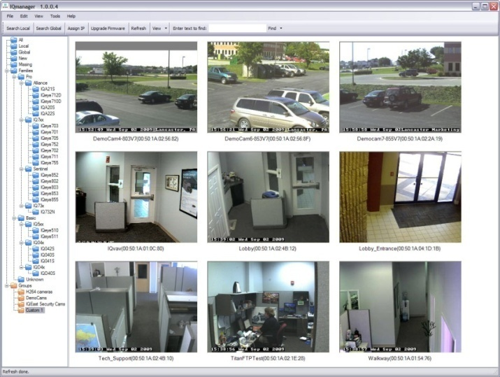




IQ Applications
  IQmanager – Windows utility for discovering and managing IQeye cameras on the network
  IQaccess – on-camera intelligent software turns IQeye camera into a basic access control system or remote attendant/notification system
  IQsentry – 4 channel full feature NVR
  IQnightlight – Used to manage difficult/fast changing lighting conditions
  Direct-to-Storage (DTS) - Used to record video directly from the camera to the storage device of choice.

Slide 50

IQmanager
  Windows utility for discovering and managing IQeye cameras on the network
  Configure network settings manually or automatically
  Batch firmware upgrades
  Group cameras
  Cut/paste camera configurations
  Drop down camera diagnostics and logging
  Automated telnet commands
  Thumbnail images

Slide 51

IQaccess
Simple access control and remote monitoring solution
  — 1 camera license required
  — Free Windows applet (8 users per camera)
  — Easy set up and use
Triggered by on-camera VMD and digital I/O
    — On-Schedule or 24/7 hour
  Pop up video window - actionable alerts
    — lock and unlock doors
    — turn-on/off lights
    — arm/disarm alarms
    — intercom/paging systems

Slide 52

IQsentry
4 channel NVR: IQNVR4
  Full-featured NVR that is easy to install and operate
  Supports Entire IQeye Product Line (H.264 and MJPEG)
  Digital PTZ control (Live and Recorded Video)
  Pre/Post alarm recording
  IQreplay (Quick and Convenient Playback)
  Single button export of video clips & snapshots
  Smart Search
  Burn video to CD/DVD
  Privacy masking
  Multiple language support
  FREE Single Camera Management Software

Slide 53

IQcameo
  Multi-stream technology
  Each stream configurable
    — Independent frame rate
    — Independent resolution
    — Independent area of interest
  One IP address
    — Auto port number
  Auto letter box for destination resolution
    — No stretching/distortion
  Up to 64 VCAMS via a NVR

Slide 54



Direct-to-Storage (DTS)

Slide 55


Traditional NVR/VMS Solution
  Multiple Client Server Architecture
  Servers request image streams from IP cameras
  Storage is added to the NVR directly or attached to the network
LAN / WAN
NVR Server with Storage
NVR Server with Storage
Client Work Stations

Slide 56


What is DTS?
  Server, Software, and Storage is re-distributed
  Server now resides on-camera
  Storage can reside on-camera or off camera
  Camera pushes video to storage target
  VMS used for configuration, viewing, playback, and etc.
LAN / WAN

Slide 57
What does a system consist of?
  IP camera with DTS functionality records directly to storage target
    — All IQeye camera models support DTS
  Storage Targets
    — Coldstore
    — NAS
    — Windows Files Share (Something as simple as a laptop WFS)
  Video Management Software
    — Automatic detection of IQeye cameras
    — VMS retrieves the live views directly from the camera
    — VMS pulls recorded video from the storage target

Slide 58

DTS Configuration

Slide 59




Associations

Slide 60




































Partners

Slide 61

Notes:
Here we have another 5 mpix image from a municipal customer in Germany for city and traffic surveillance

Slide 62

Eastern Maine Medical Center, Bangor, Maine

Slide 63


Slide 64


Slide 65


Slide 66


Slide 67


Slide 68
Notes:
And speaking of “Never missing a thing” here’s an image from a high-end International jewelry store called Bulgari.
Click Animation to zoom windows - Using a 5 megapixel camera, they were able to cover most of their show floor without the risk of missing anything. When you consider there’s over $250 million dollars worth of product on display, that’s pretty important!
GO to next slide

Slide 69


Slide 70


Slide 71


Slide 72

Notes:
This customer replaced their mechanical PTZ camera with a single 2 megapixel camera which offered enough detail for them to ID cars, and in some cases employees.

Slide 73


